Slide 1
Remote Sensing (RS) Image Fusion
B. Harshavardhan (1602-19-737-072)
K. Krishna (1602-19-737-077)

Slide 2
Abstract
Image Fusion is used to retrieve important data from a set of input images and put it into a single output image to make it more informative and useful than any of the input images.
Fusion of 2 images helps to get the best out of both the images hence better information can be retrieved.

Slide 3
Problem Statement
Images from different satellites have different resolutions and contain different information of the same location.

Slide 4
Literature Survey
Metwalli, Mohamed & Nasr, A.H. & Faragallah, Osama & El-Rabaie, El-Sayed. (2010). Image Fusion Based on Principal Component Analysis and High-Pass Filter. 63 - 70. 10.1109/ICCES.2009.5383308. - proposes a two-stage image fusion algorithm using PCA and high-pass filtering. The method has been well-received in the literature for its simplicity and computational efficiency, and has been shown to produce high-quality fused images, particularly for images with similar illumination and contrast. However, some studies have noted that the method may not be suitable for all types of images or for images with large differences in illumination or contrast. Further research is needed to compare the method to other fusion techniques and to investigate its performance under different conditions.

Slide 5
Image fusion techniques for Remote Sensing Optical Payloads – Case study on Sentinel Imagery and Visualization using OSG Earth - Report of seniors 2022 batch as reference for extension
Generative Adversarial Networks for Image Super-Resolution: A Survey. Open Archives : https://arxiv.org/abs/2204.13620 , 2022 - provides a comprehensive overview of recent advances in image super-resolution using generative adversarial networks (GANs). The survey covers a wide range of GAN-based approaches and discusses the challenges and opportunities of using GANs for image super-resolution. The authors provide insights into the strengths and weaknesses of different GAN architectures and loss functions and highlight several open research directions that could drive future advancements in the field. Overall, the survey serves as a valuable resource for researchers and practitioners interested in GAN-based image super-resolution, and provides a clear roadmap for future research in the area.

Slide 6
Proposed Work
GAN & Super-Resolution Generative Adversarial Networks (SRGAN)
Generation of high resolution images using low/poor resolution imagery.
Comparative Study of SRGAN results with the PCA and Wavelet.
Development of Framework for Satellite Imagery Search, order, Apply Image Fusion and visualize

Slide 7

Proposed Architecture/Design - Framework
QGIS
Add layers
Area Selection/Shape Creation
Viewing the Orbit tracks in QGIS
Placing the order for imagery
plugin
Input Image 1
High Resolution Image
Image Fusion-SRGAN
Download the imagery
Input Image 2
Notes:
Add a diagram for SRGAN from different satellite of the same imagery. QGIS.

Slide 8
Experimental Setup
Software requirements:
Jupyter Notebook
QGIS Software
Hardware Requirements
GPU

Slide 9
Evaluation Metrics
MSE and SSIM is used to estimate which technique is more suitable for sentinel-2 imagery.
MSE – Mean Squared Error
SSIM - Structural Similarity Index Measure

Slide 10
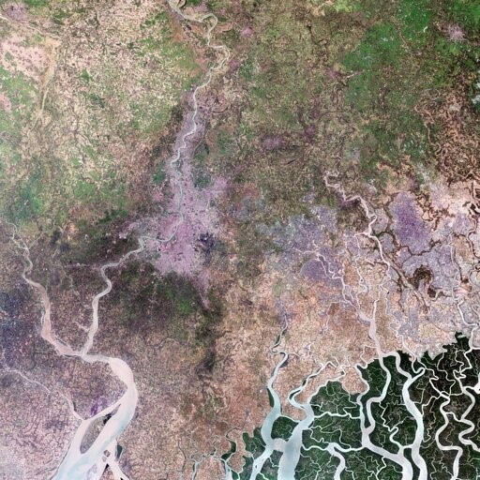

Results
Original Image
512X512
128KB
SRGAN Output
2048X2048
820KB
PSNR: 21.398830

Slide 11
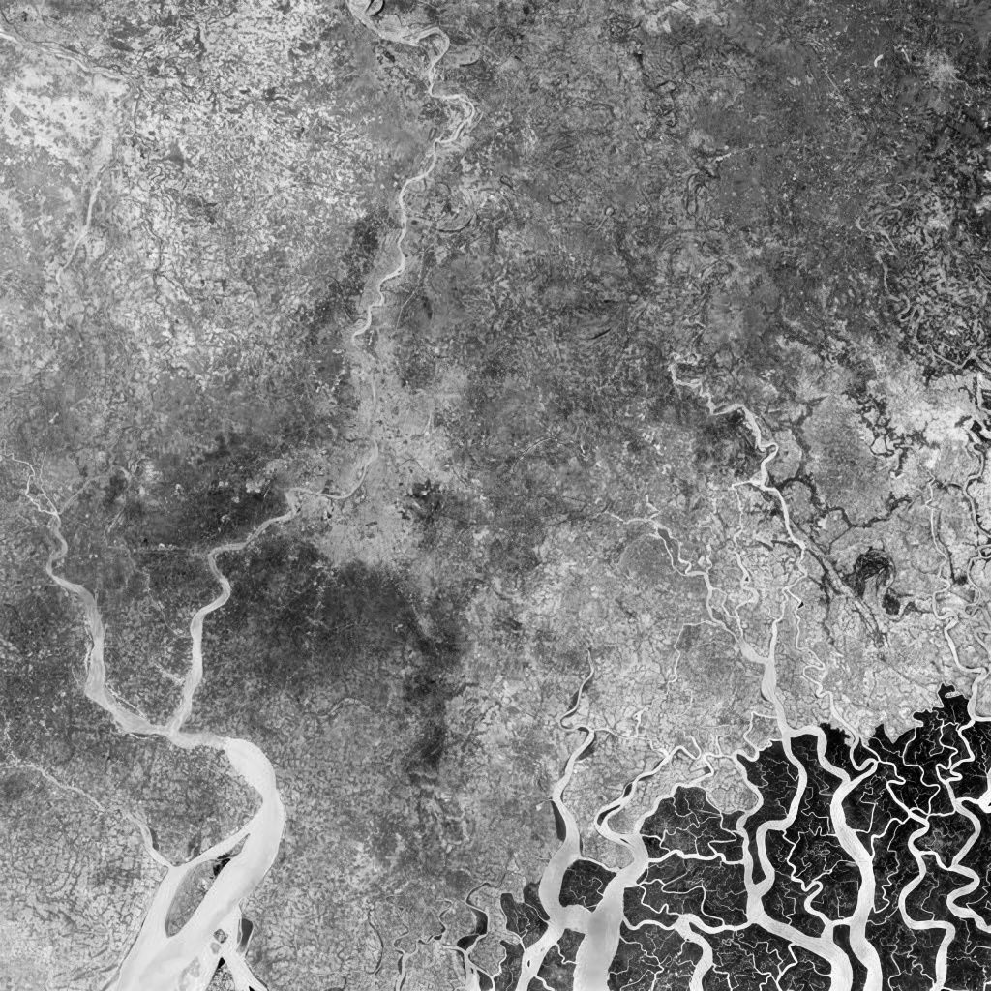
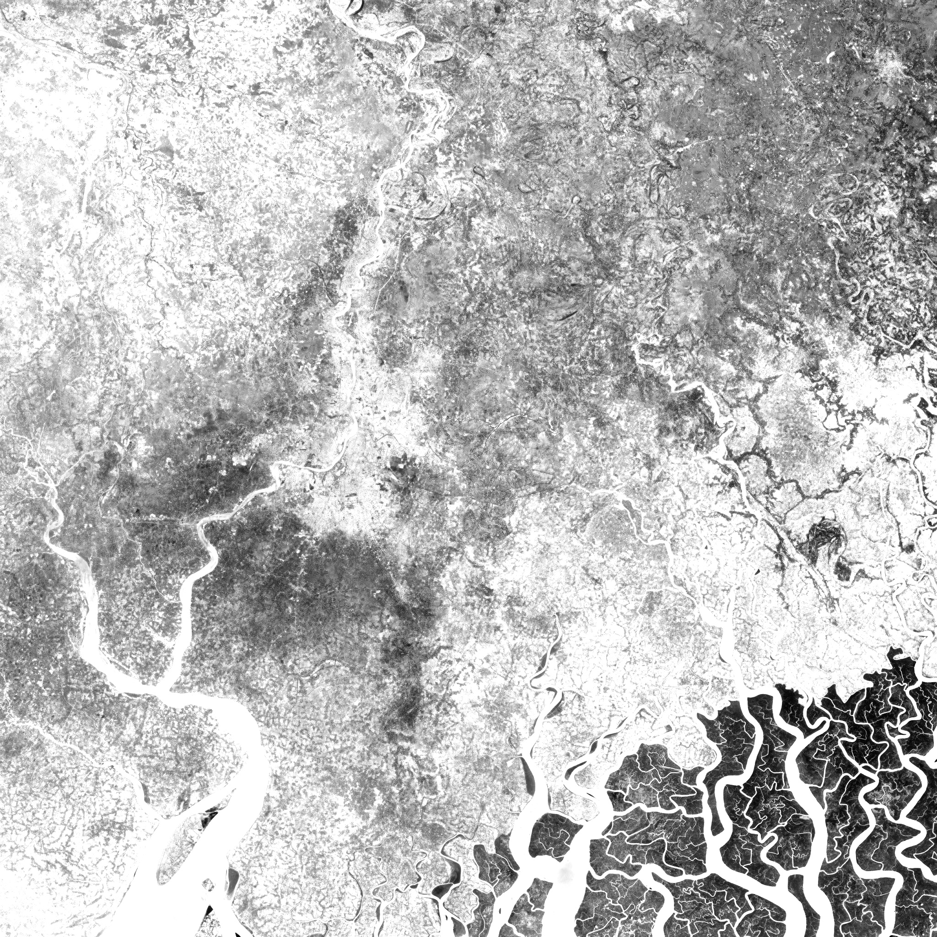
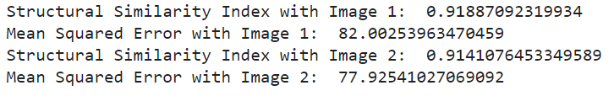
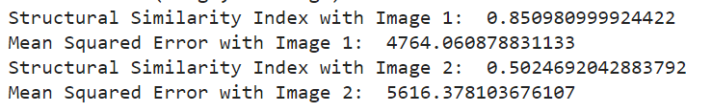
Results
Wavelet
PCA

Slide 12
Analysis
Performed image fusion on Sentinel-2A satellite data using machine learning algorithms.
Algorithms used : PCA and Wavelet Transforms.
SRGAN for image upscaling

Slide 13
Conclusion and future scope
Conclusion: wavelet-based image fusion technique is more suitable.
Future Scope: Using GAN for fusion of images.

Slide 14
Thank You

Slide 15
Thank You

Slide 16
Additional Slides

Slide 17
Objective
Design and development of a system for image fusion to achieve super resolution for remote sensing images such as satellite imagery.
Super Resolution(SR) is highly demanded processing technique for satellite imagery to improve the quality(resolution) from low resolution imagery.

Slide 18
Reference Papers
Metwalli, Mohamed & Nasr, A.H. & Faragallah, Osama & El-Rabaie, El-Sayed. (2010). Image Fusion Based on Principal Component Analysis and High-Pass Filter. 63 - 70. 10.1109/ICCES.2009.5383308. - PCA reference paper
Image fusion techniques for Remote Sensing Optical Payloads – Case study on Sentinel Imagery and Visualization using OSG Earth - Report of seniors 2022 batch as reference for extension
Generative Adversarial Networks for Image Super-Resolution: A Survey. Open Archives : https://arxiv.org/abs/2204.13620 , 2022 - Paper Referred for the proposed work

Slide 19
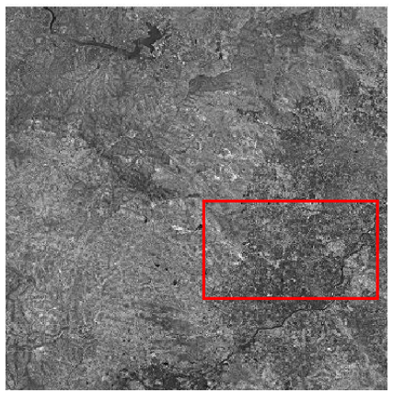
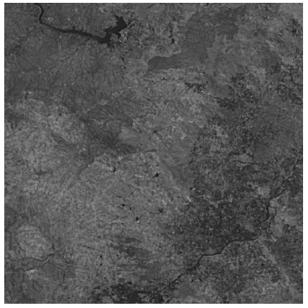
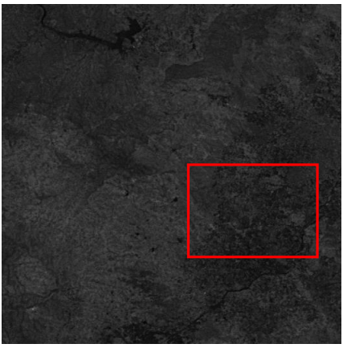
Image Fusion-PCA and Wavelet based ( The problem already addressed)
Wavelet based fused image
Performed image fusion on Sentinel-2A satellite data using machine learning algorithms.
Algorithms used : PCA and Wavelet Transforms.
MSE and SSIM is used to estimate which technique is more suitable for sentinel-2 imagery.
Conclusion: wavelet-based image fusion technique is more suitable.
Original Sentinel-2A image
PCA based fused image

Slide 20
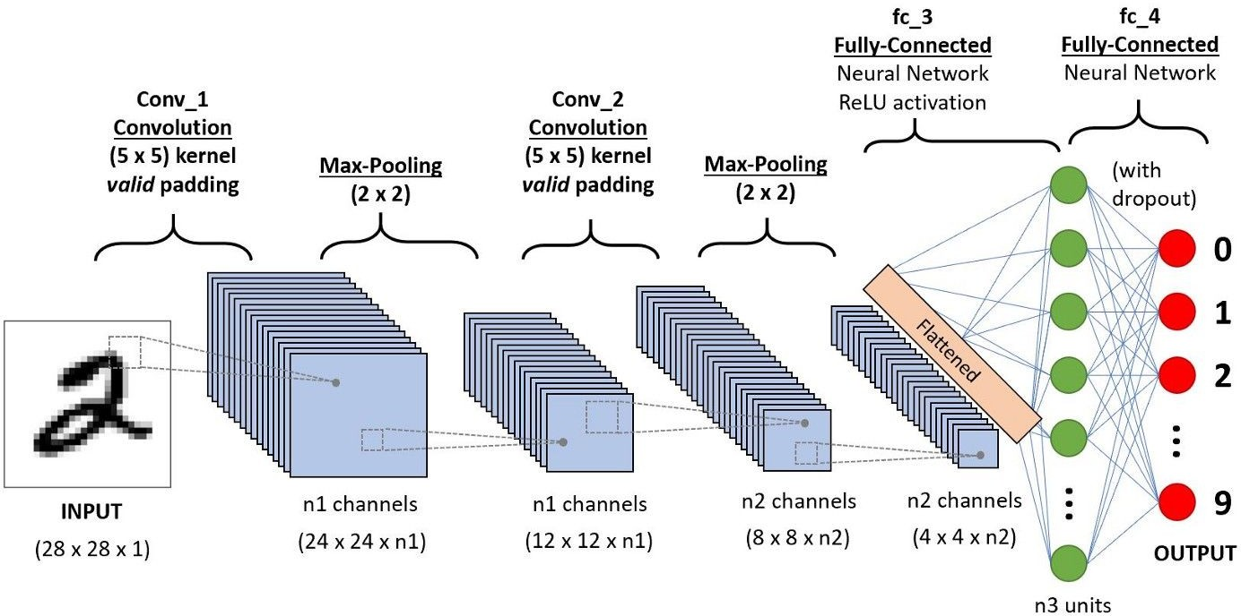
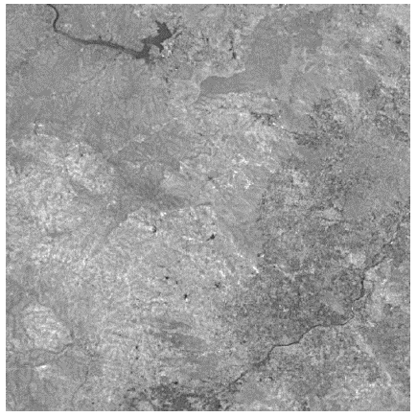
What is GAN?
G - Generator
Generates(creates) fake data
A - Adversarial
Generator and Discriminator each competing to win.
Generator trying to create more accurate fake data, whereas Discriminator trying not to get fooled by generator.
Output
28x28x1
N - Networks
Deep Convolutional Neural Networks

Slide 21
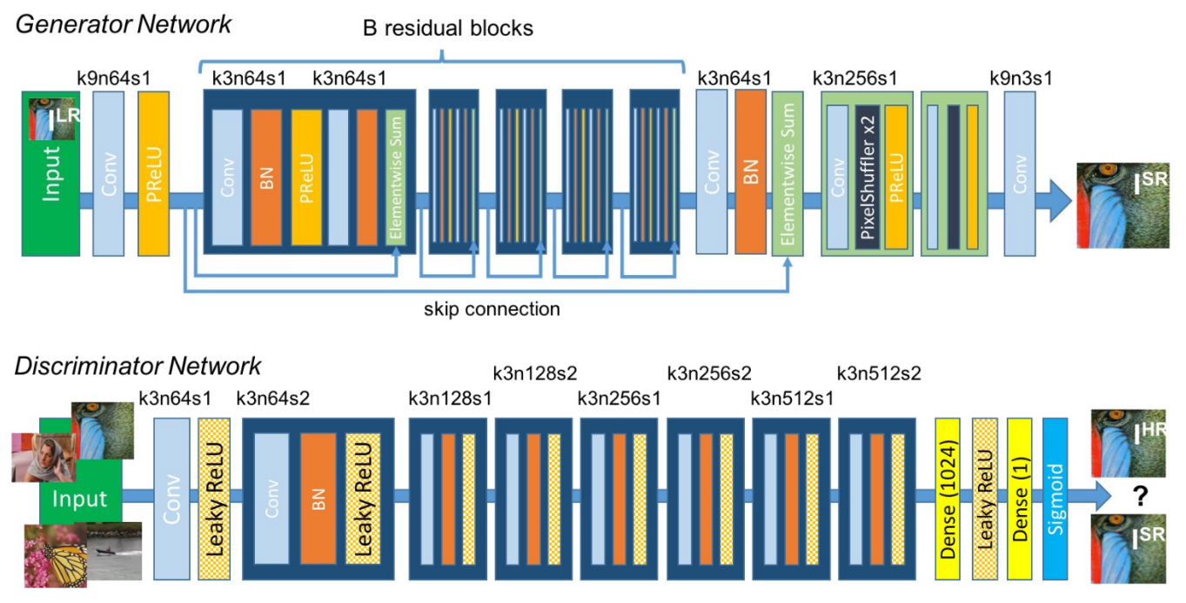
SR-GAN Model
Generator:
Same as SRGAN’s generator
With two additional residual blocks (a total of 18 RB)
InstanceNorm (*)
Discriminator
Fully Convolutional discriminator
8x lower parameter count
4M compared to 38M (SRGAN)
efficient to optimize

Slide 22
Original Image
512X512
128KB
SRGAN Output
2048X2048
820KB

Slide 23
Wavelet
PCA

Slide 24
Additional Reference Papers
Scarpa, Giuseppe & Gargiulo, Massimiliano & Mazza, Antonio & Gaetano, Raffaele. (2018). A CNN-Based Fusion Method for Feature Extraction from Sentinel Data. Remote Sensing. 10. 236. 10.3390/rs10020236.
Krista Amolins⁎, Yun Zhang, Peter Dare, Wavelet based image fusion techniques — An introduction, review and comparison, ISPRS Journal of Photogrammetry & Remote Sensing 62 (2007) 249 – 263.
Kaur, H., Koundal, D. & Kadyan, V. Image Fusion Techniques: A Survey. Arch Computat Methods Eng 28, 4425–4447 (2021).
Size Li, Pengjiang Qian, Xin Zhang, Aiguo Chen, Research on Image Denoising and Super-Resolution Reconstruction Technology of Multiscale-Fusion Images, Mobile Information Systems, vol. 2021, Article ID 5184688, 11 pages, 2021. Andrea Garzelli, A Review of Image Fusion Algorithms Based on the Super-Resolution Paradigm, Remote Sens. 2016, 8, 797.

Slide 25
Thank You

Slide 26
Performed image fusion on Sentinel-2A satellite data using machine learning algorithms.
Algorithms used : PCA and Wavelet Transforms.
MSE and SSIM is used to estimate which technique is more suitable for sentinel-2 imagery.
Conclusion: wavelet-based image fusion technique is more suitable.

Slide 27
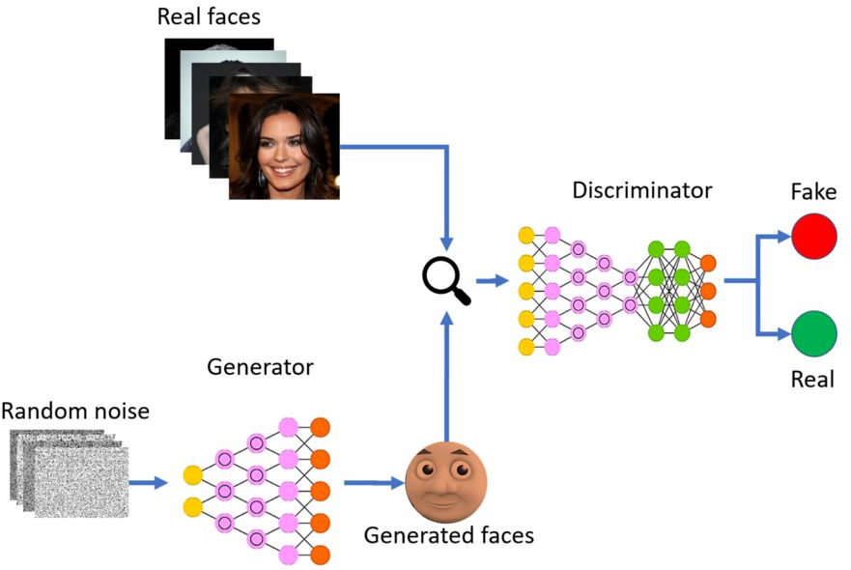
Steps for GAN
Define architecture.
Train Discriminator.
Train Generator.
Train Discriminator and Generator for multiple epochs.

Slide 28
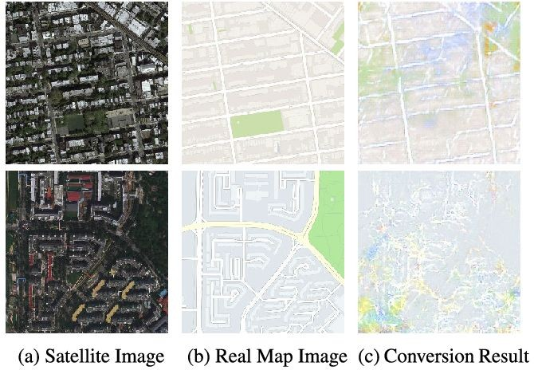
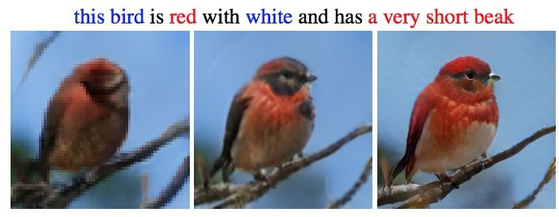
Applications of GAN
Generating fake data for augmenting other ML algorithms.
Image-To-Image Translation.
Text-To-Image Translation.
Super Resolution. (SR)
Domain Transfer. (like LM to EM)

Slide 29
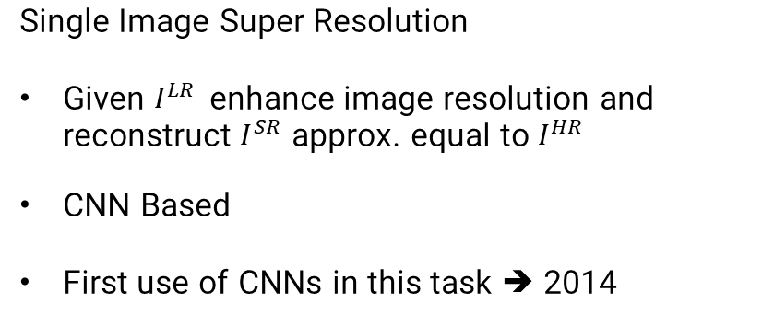
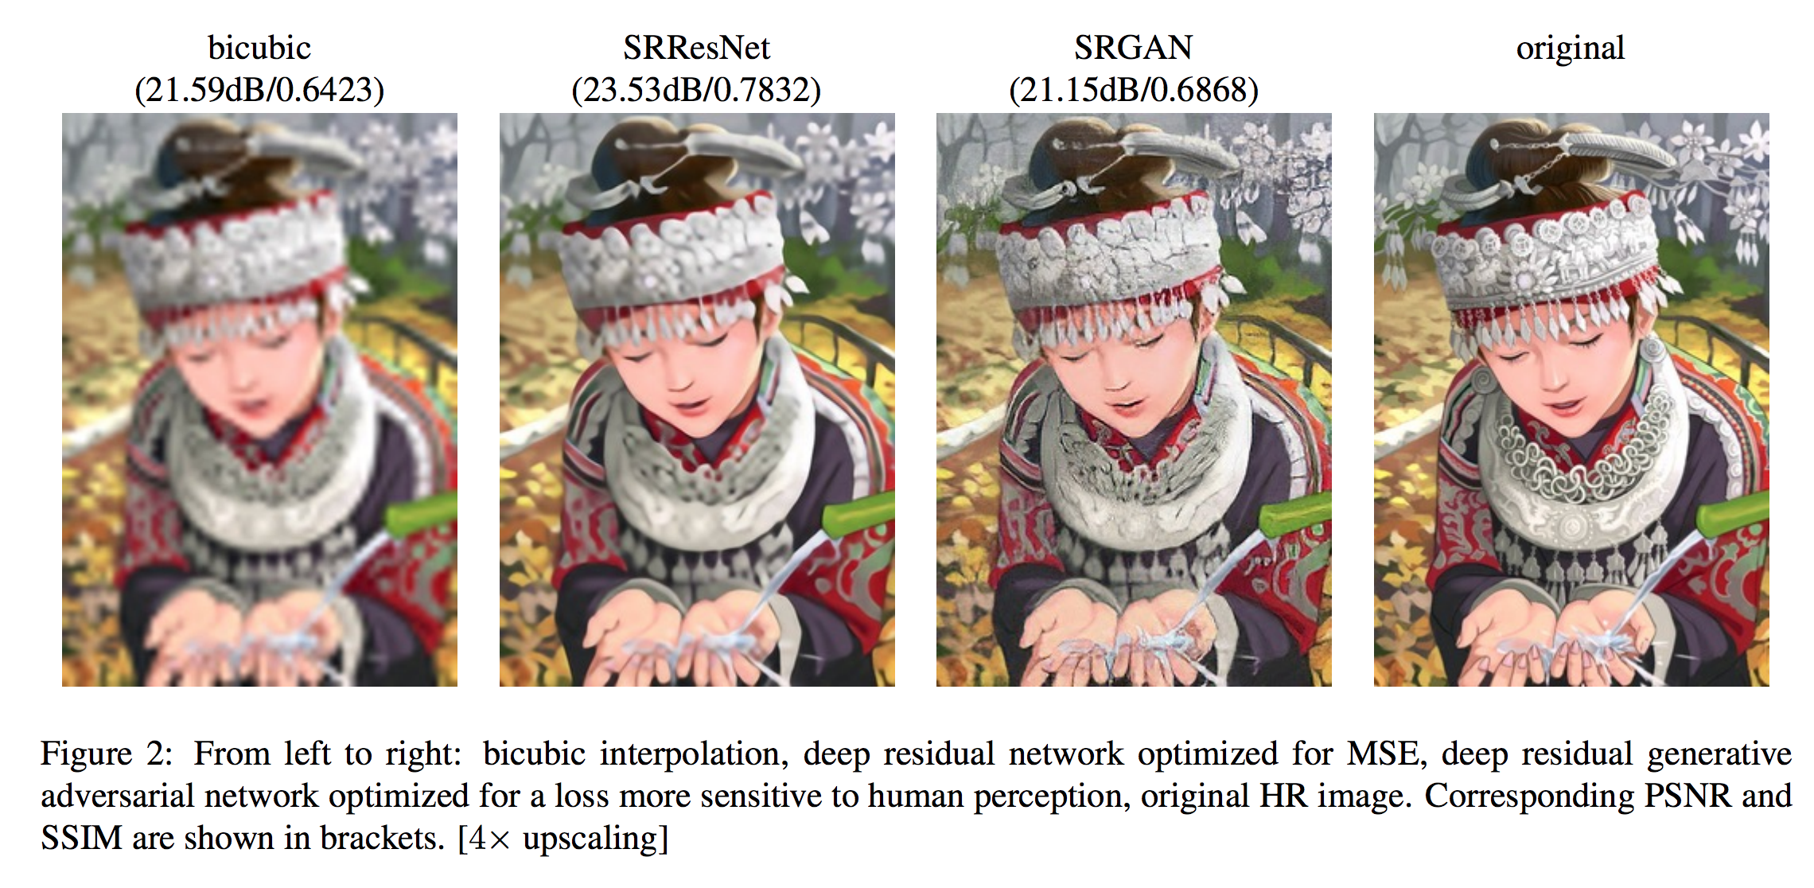
Introduction
Challenges
Network architecture
Loss function
Training procedure
Up-sampling method
Real-time
Applications
Surveillance and security
Satellite images
Video and Image enhancement
Smartphones
Preprocessing for some applications to improve results
29

Slide 30
Proposed Methodology Block Diagram
Low resolution image
SRGAN
High Resolution SRGAN Output
Image Fusion (PCA & Wavelet)
Fused Image
Actual High Resolution Image

